Slide 1
Analysis of headphones market for mark 7600
Ameya jamgade
Mark aw
Rahul Potluri
Tommy zhu
Yan yang

Slide 2
Overview
US earphones & headphones market
$5 billion industry by 2020
Objectives
Analyze & evaluate market
Understand consumer preferences
Estimate market share

Slide 3



The players

Slide 4

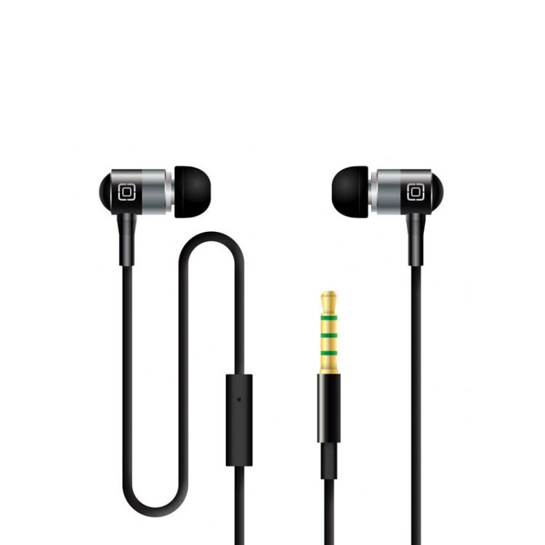
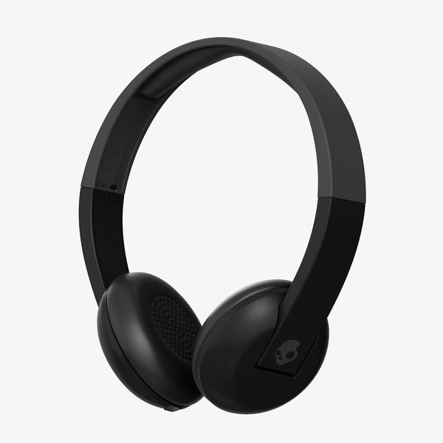

attributes
$50
Type
Price
$150
$250

Slide 5
attributes
Wired
Connectivity
Brand
Bluetooth

Slide 6
The design
Conjoint vs Discrete choice
Discrete choice
More convenient
Better insights
D-efficiency: 99.33
Std error: 0.58
48 choices
3 blocks of 16 each, n > 25 for each block

Slide 7
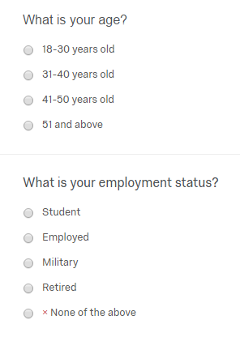
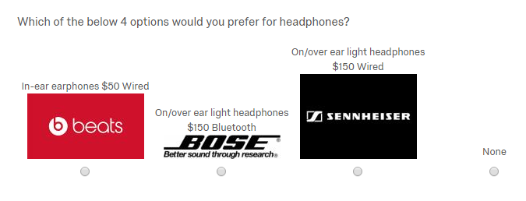
questions

Slide 8
the results

Slide 9
analysis

Slide 10
analysis

Slide 11
analysis

Slide 12
observations
As price decreases
Market share increases
At every price point
Market share increases with added features
Gains in market share
Mic, Bluetooth: 1-2%
Price decrease: 3-6%

Slide 13
observations
Market share did not differ significantly from cumulative average
Shows market share is fairly consistent
Lowest market share: Sennheiser
Smallest gains in market share with added features
Gains from Bluetooth addition at $250 price point
Bose: 3%
Sennheiser: 1%

Slide 14
limitations
Target respondents
Headphones are not a daily necessity
Limited number of attributes
Lower average income level
59% were students
Younger average age
81% are from 21-30 age group

Slide 15
recommendations
Bose should continue its marketing strategy
Maintain consistent quality levels
Maximize profits at highest price levels
Beats should seek different avenues to increase market share
Improve quality
Lower price
Sennheiser needs a thorough analysis of its products
Revise existing products
New product development

Slide 16
Q&A

